Slide 1
Spam Likely
A Supervised Machine Learning Email Spam Classifier
Jackson Trader, Alex Bryant, Diego Lara, Mark Pack
Group 5 | Fall 2025 | CS46200
Notes:
(Jackson Trader)
Title & Intro

Slide 2
Motivation
Why Email Spam Classification?
Affects everyone from individuals to businesses
Increasingly difficult to identify spam from legitimate emails
Goal → Automatically classify emails as spam or legitimate
Notes:
(Alex Bryant)
Motivation

Slide 3
Research Problem
Research Question & The Problem
Could machine learning classify emails using only message text?
Binary Classification → spam vs. ham (legitimate)
Compare baseline models with a more advanced model
Notes:
(Alex Bryant)
Research Problem

Slide 4
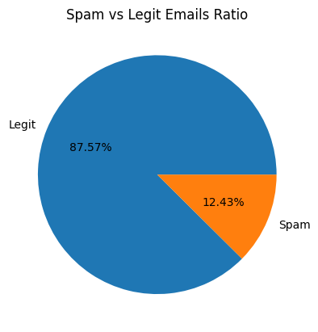
Dataset Overview
Email Spam Dataset
Kaggle email spam dataset (5,572 emails)
87.57% legitimate, 12.43% spam (imbalanced)
Each email contains a category and message
Required some data wrangling beforehand
Notes:
(Diego Lara)
Dataset Overview

Slide 5
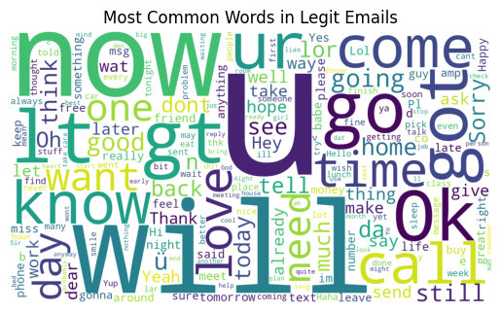
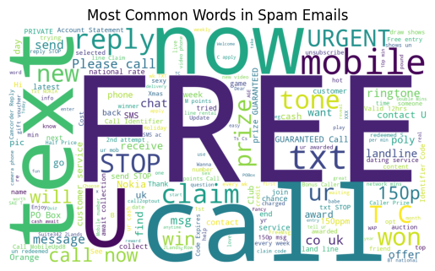
WordClouds
Notes:
(Jackson Trader)
WordClouds

Slide 6
Why These Models?
Baseline Models vs. Primary Model
Logistic Regression → Estimates probability of an email being either spam or legitimate
Multinomial Naïve Bayes → Probabilistic model using frequencies to estimate likelihoods
LinearSVC → Effective for high-dimensional TF-IDF feature spaces
Notes:
(Jackson Trader)
Why These Models?

Slide 7
Proposed Method / Solution
The Process
Preprocess raw email messages
Convert text into numerical feature vectors using TF-IDF
Train multiple supervised machine models
Evaluate models using Scikit-learn’s classification metrics
Notes:
(Jackson Trader)
Proposed Method / Solution

Slide 8
Experimental Settings
Training & Evaluating Our Models
Jupyter Notebook in Python & Google Colab IDE
Libraries → NumPy, Pandas, Matplotlib, WordCloud, Scikit-learn
Stratified split to preserve 80/20 percent distribution
Same TF-IDF numerical vector features used for all models
Notes:
(Diego Lara)
Experimental Settings

Slide 9
Evaluation Metrics
How Performance is Measured
Accuracy → How often the model is correct overall
Precision → Of emails labeled spam, how many are actually spam
Recall → Of all real spam emails, how many did the model correctly catch
F1 Score → Mean of precision and recall metrics
  Important for evaluating performance on imbalanced datasets
Notes:
(Jackson Trader)
Evaluation Metrics

Slide 10
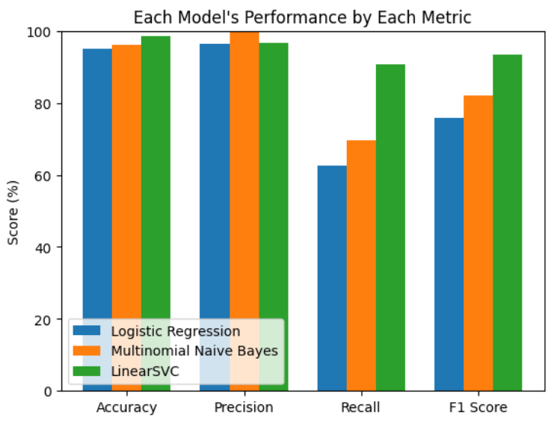
Experimental Results & Comparison
Comparing All Models
Logistic Regression and Naïve Bayes performed well
LinearSVC achieved the strongest overall performance
Notes:
(Jackson Trader)
Experimental Results & Comparison

Slide 11
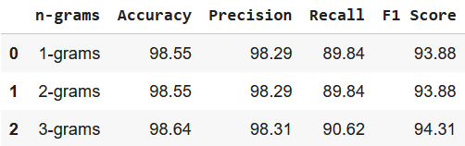
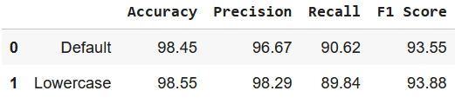
Other Experiments
Effects of Changing Preprocessing & Hyperparameters
N-gram Range Experiment → Increasing range had minimal improvement
Ablation Study → Lowercasing vs. Default Messages
Results → Changes led to diminishing returns across the metrics
LinearSVC only used for other experiments
Notes:
(Mark Pack)
Other Experiments

Slide 12
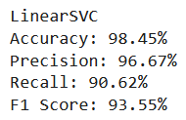
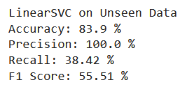
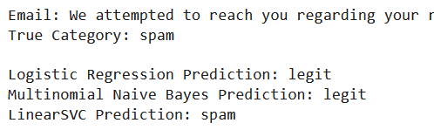
Unseen & Paraphrased Data
Generalization Tests
Accuracy/Precision remained high
Recall and F1 score dropped significantly
Generalization is difficult; many patterns
LinearSVC only used on this test as well
Notes:
(Mark Pack)
Unseen & Paraphrased Data

Slide 13
Live Demo!
Notes:
(Jackson Trader)
Live Demo

Slide 14
Conclusion & Future Work
Supervised machine learning models are effective for spam classification
LinearSVC performed best overall
Future Work:
  Add more email features (ex. subject, sender)
  Larger and more diverse datasets
  Tune hyperparameters of TF-IDF
  Change preprocessing techniques
Notes:
(Mark Pack)
Conclusion & Future Work

Slide 15
Thank you!
Any Questions?
Let us know.
Notes:
(Jackson Trader)
Thank You

